Slide 1
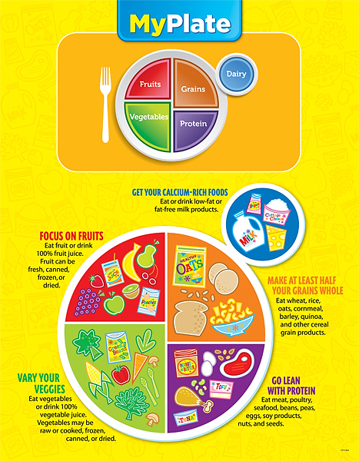
Facts to Know
Healthy Diets
Name_________________
Test Date_________________

